Slide 1



My Final Project
Presented by: Salma Faska
Course : Graphic design senior

Slide 2



My brand logo :
Source of inspiration
Dream job
My city

Slide 3
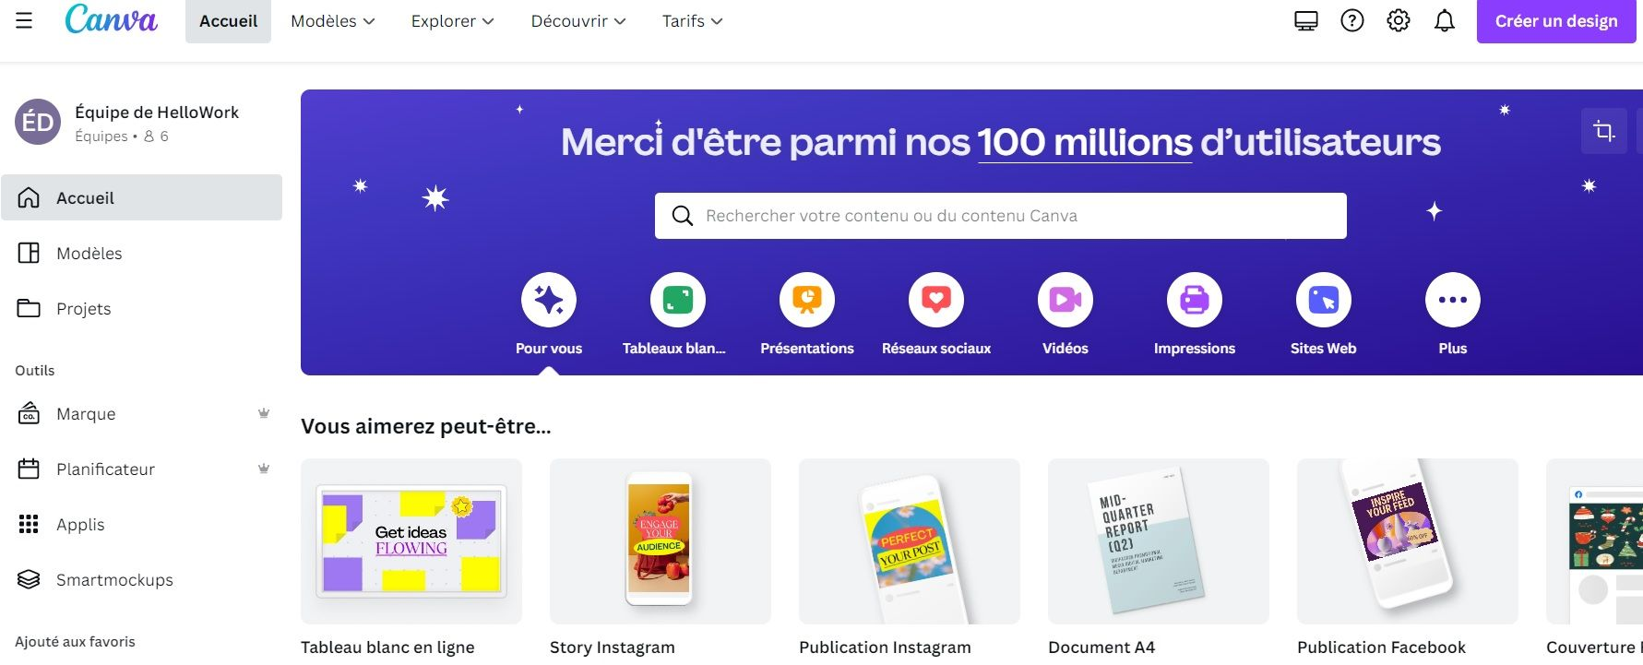


Graphic design platform
Question: What tools did i use for my project ?

Slide 4

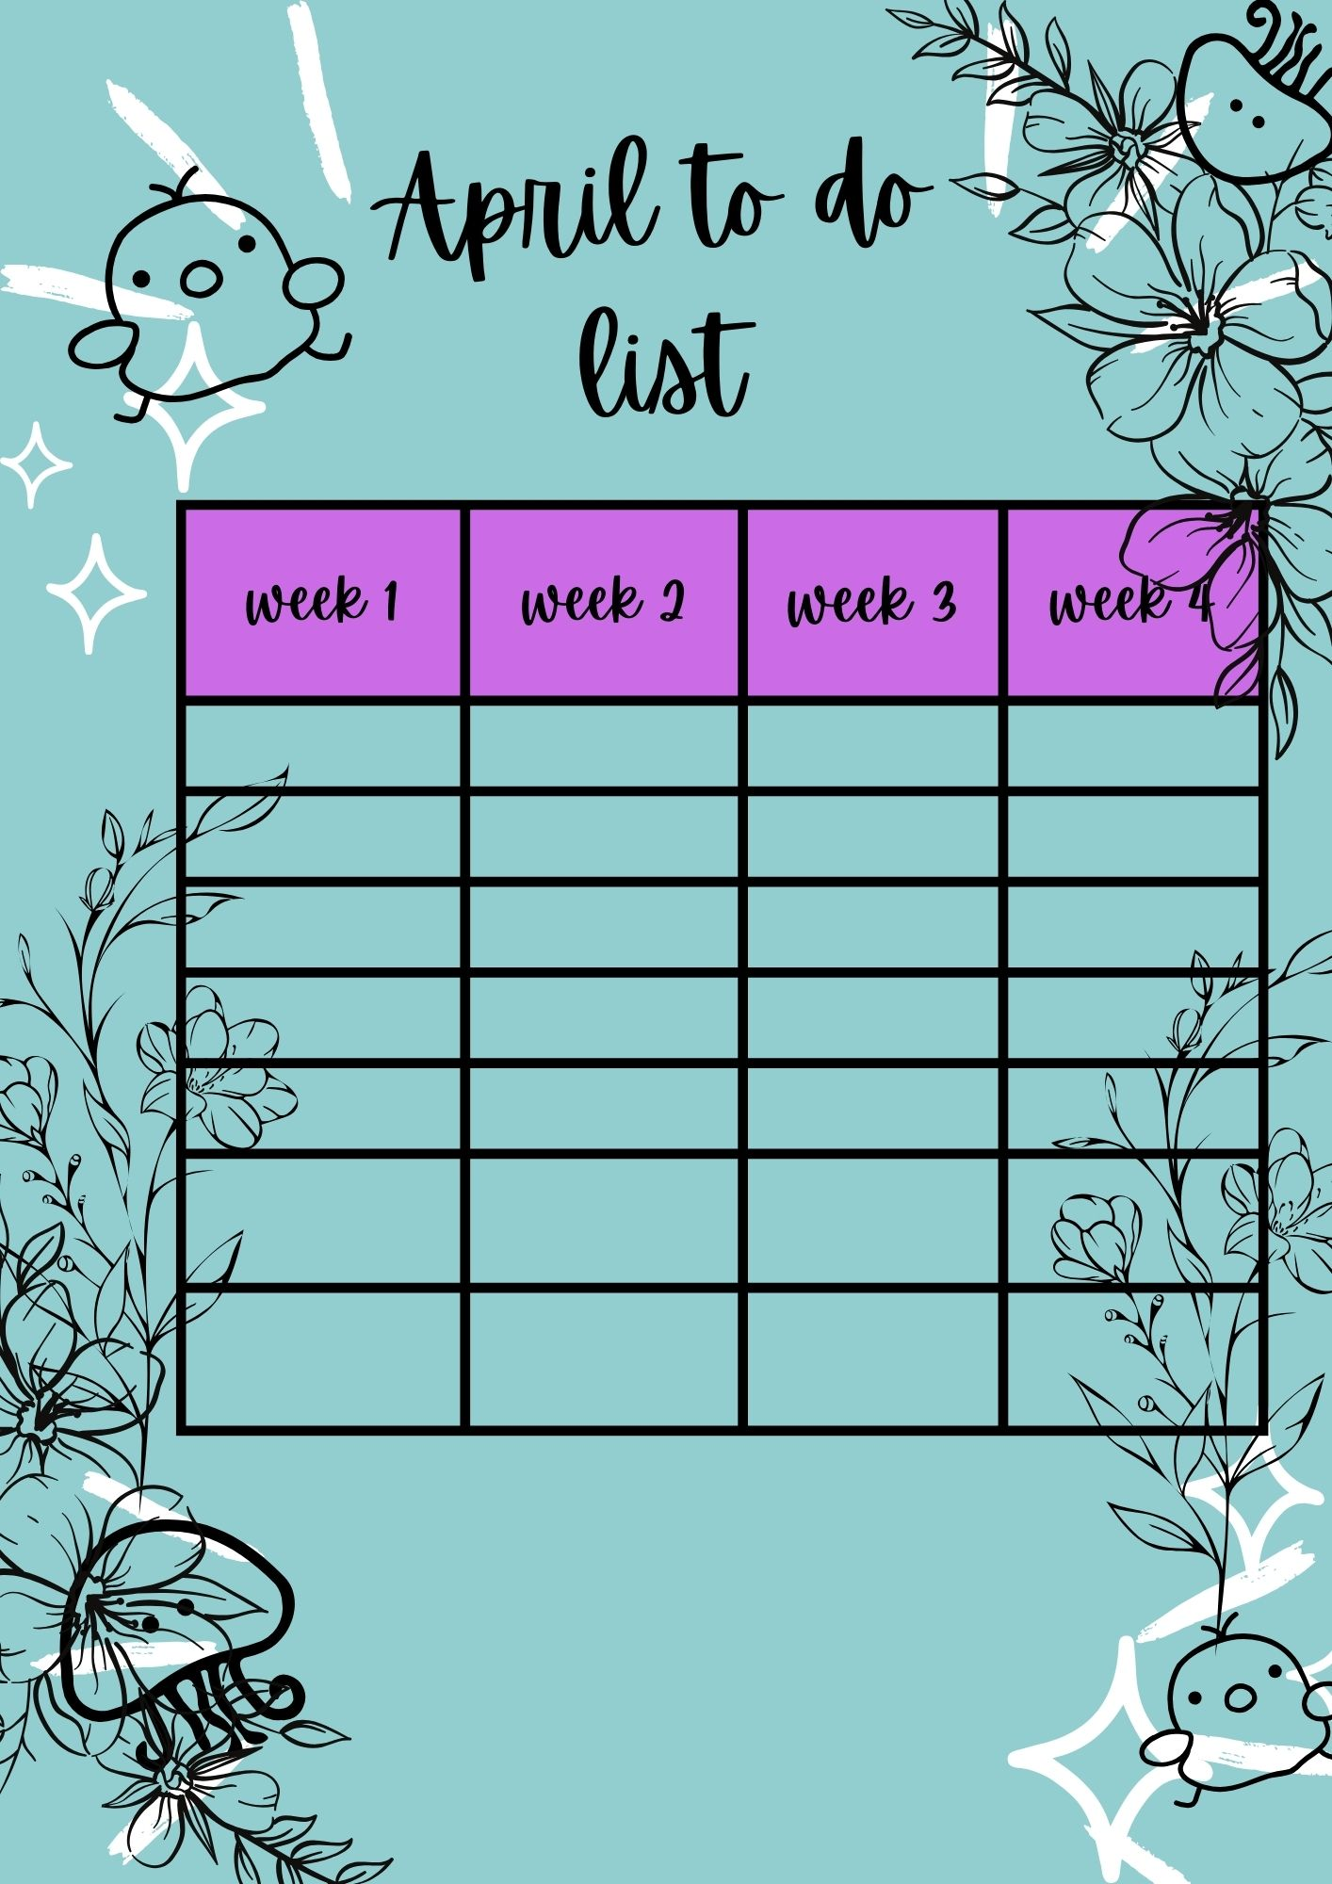
I made some other projects like my to do list project and my april calendar :

Slide 5


This is my space project ❤️
Gimp

Slide 6

“Innovative Design is for Every Business !"
salma.faska.algo@outlook.com

